Slide 1

Getting Ready to Use the All of Us Researcher Workbench: Using Jupyter Notebooks with R

Slide 2
Header
Learning Objectives
All of Us Research Program background and description
Terminology, concepts and structures
Jupyter Notebooks and R

Slide 3
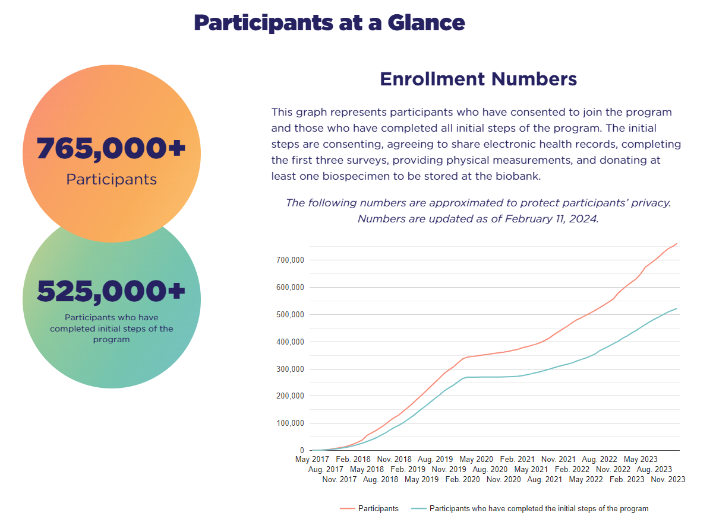
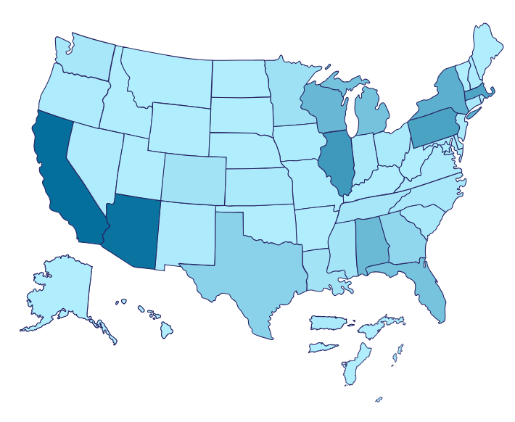
Who are the participants in All of Us?
1,163,00 people have registered

Slide 4
Kinds of Access to the Datasets
There are three levels of access to the All of Us datasets. All data is stored in the “Research Hub” https://www.researchallofus.org/
Public Tier
Registered Tier
Controlled Tier

Slide 5
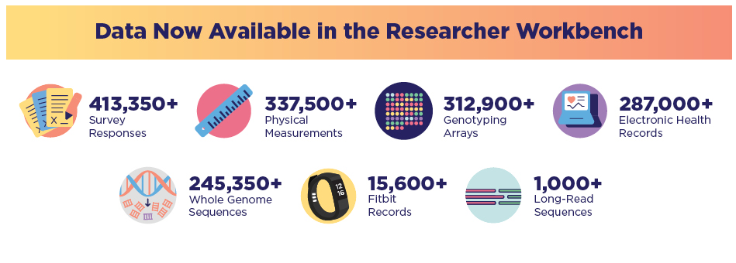
What kind of data is in All of Us?

Slide 6







What is the All of Us Researcher Workbench?
A platform (web interface) to retrieve and analyze the All of Us data
Diagram of tools and their relationships on the Workbench:
COHORT
BUILDER
USES:
Organizing research projects
Collaboration
Transparency
USES:
Pre-populated analysis
Dataset previews
USES:
Cohort creation
DATASET
BUILDER
WORKSPACES
USES:
Concept set selection
WORKBENCH
USES:
Analysis
Queries
Uses programming languages R and Python
CONCEPT
SET SELECTOR
USES:
Learning and training
Personalized support
Guides
NOTEBOOKS
WORKBENCH USER SUPPORT HUB

Slide 7
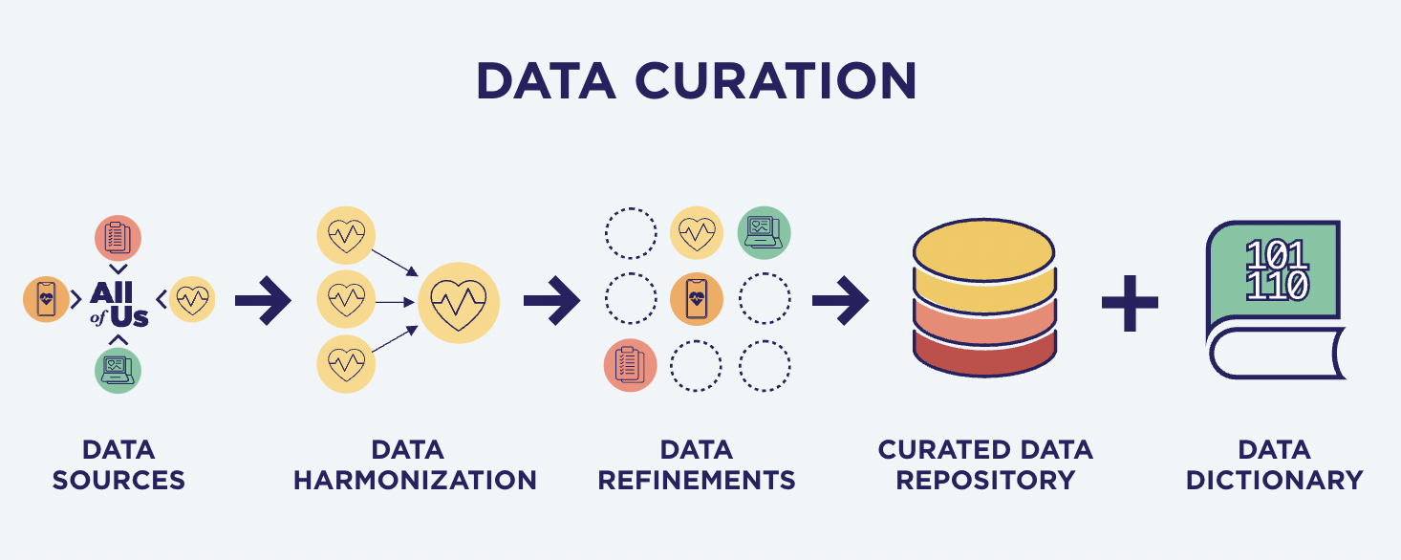
Where is the data that is being accessed on the Jupyter Notebook?
The data dictionary is an Excel file:
Spreadsheets of all the data types
and explanations of them in
more detail
Link to it is under ‘Data Methods’ in
in the Research Hub
SQL
=
‘Structured Query Language”; SQL is a common programming language for using with relational databases
The Curated Data Repository (CDR) is a BigQuery data warehouse:
Cloud platform that stores the data
SQL queries can retrieve data from the CDR one of two ways:
Using the Researcher Workbench tools to automatically generate
SQL code in the Jupyter Notebook
Writing SQL code manually in the Jupyter Notebook

Slide 8
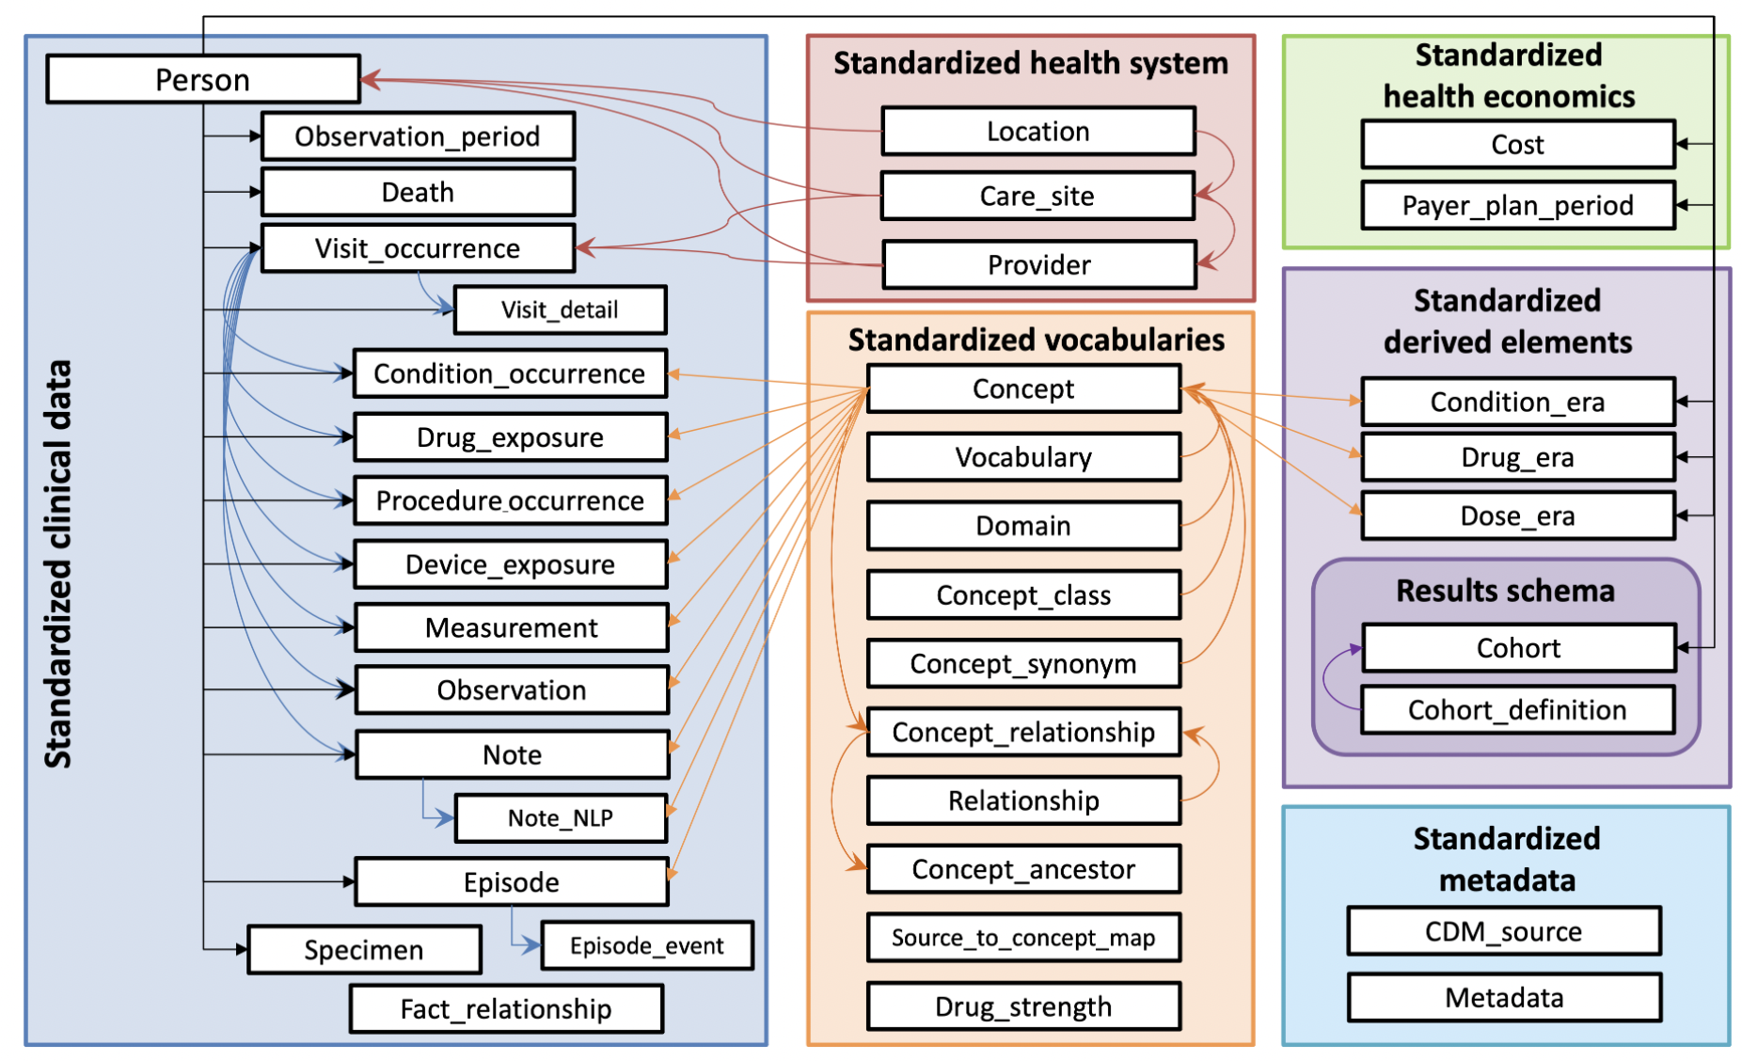

Where is the data that is being accessed on the Jupyter Notebook?
The CDR has some data stored according to the OMOP common data model (CDM) from OHSDI (ohdsi.github.io/CommonDataModel/)
More details can be found from the All of Us Office Hours 10/16/2020 “AoU use of OMOP for CDR” video
https://youtu.be/jK11qAus8Q8
we can retrieve our dataset of interest from CDR with code (SQL queries) by either using the Researcher Workbench web interface tools to generate this code OR by writing our own code in the Jupyter Notebook

Slide 9






Researcher Workbench Storage Options
Standard VM
Dataproc Cluster
d
Default when attached
Commanded via Code Snippets
Default
Persistent Disk
Workspace Bucket
Standard Disk
Permanent storage
Does not require file directing
Non-shareable; specific to the researcher and workspace
Can be thought of as a “USB thumb drive”
Permanent storage within Google Cloud Platform
Shareable; anyone with access to the workspace can access the bucket
Can call files into any notebook within the workspace
Not permanent, can be thought of as “scratch storage”
Specific to environment, when the environment is deleted, all files are deleted
Located within the Jupyter terminal of your notebook

Slide 10

What are Workspace Buckets, and what are they used for?
Workspace Bucket = permanent cloud storage available for your Workspace
Each workspace has its own unique Uniform Resource Identifier (URI) which can be accessed from other Workspaces
Saving files to the Workspace Bucket
Jupyter Notebooks are saved automatically
Other files must be saved manually
Files can be accessed across Jupyter Notebooks and Workspaces
Take advantage of Workspace Buckets to save and retrieve your dataset
Easily retrieve a dataset without rewriting the SQL query or reformatting the data
May cost less to save and retrieve the data

Slide 11
